Slide 1
Chapter 3
Enterprise Management Systems

Slide 2
Enterprise Management System
EMS is concerned with control, monitoring and the management of IT infrastructure and applications in order to optimize IT service delivery in Company.
EMS is wide information system designed to coordinate all the resources, information and activities needed to complete business processes.
Enterprise – an entire company, everything, all-inclusive
Management – The monitoring and controlling of entities
Systems – Information Technology Infrastructure, hardware and software, data, information, and processes

Slide 3
Enterprise Software
Enterprise software is any software used in large organizations (whether business or government).
It is considered to be an essential part of a computer-based information system, and it provides business-oriented tools such as online payment processing and automated billing systems.
Enterprise software is also referred to as enterprise application software.

Slide 4
Enterprise Resource Planning
ERP is business process management software that allows an organization to use a system of integrated applications to manage the business and automate back office functions.
ERP software integrates all facets of an operation, including product planning, development, manufacturing processes, sales and marketing.
Some of ERP’s functions include:
  Bookkeeping & Accounting
  Human Resource Management
  Planning Production
  Supply Chain management

Slide 5
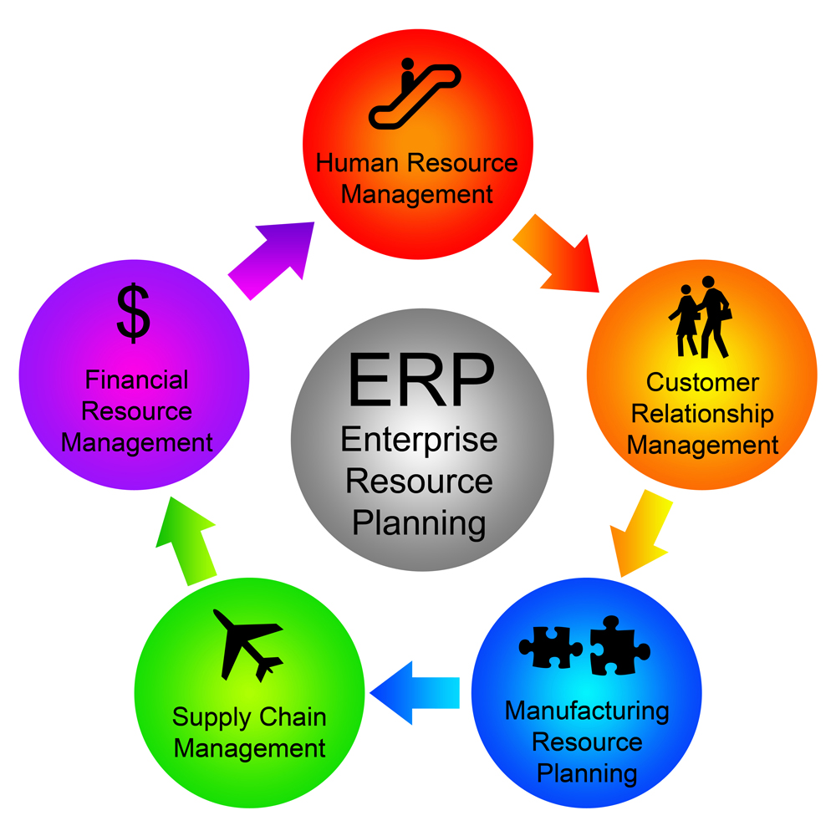
ERP Components

Slide 6
Enterprise Resource Planning Software
It helps an organization to integrate information flows, operations and processes all resources accessible, for example, materials, work force, machine and money.
The focus of ERP is on resource management within constraints to maximize the return on investment.
These data are then stored in a unified database, which are the key for the success of this software solution.
The ERP package design is built on the principle of Best Practices.
ERP Software: SAP, Supply Chain Management, CRM
Notes:
The most demanding and successful solution for the modern business organization is an Enterprise Resource Planning software.

Slide 7
Supply Chain
A supply chain is the system of organizations, people, activities, information and resources involved in moving a product or service from supplier to customer.
Supply chain activities transform raw materials and components into a finished product that is delivered to the end customer.

Slide 8







Supply Chain
Supplier
Manufacturer
Distributor
Retailer
Customers

Slide 9
Supply Chain Management
Supply Chain Management is
the design and management of processes
across organizational boundaries
with the goal of matching supply and demand
in the most cost effective way.
Supply
Demand
Matching Supply and Demand

Slide 10
Customer Relationship Management
Customer Relationship Management is a strategy for managing all your company’s interactions with current and prospective customers.
CRM formation of bonds between a company and its customers.
CRM enables your company to increase productivity, close more business, and improve customer satisfaction and retention.

Slide 11
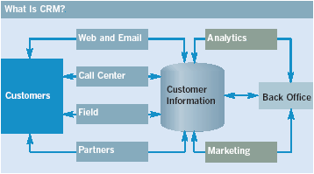
Model of Customer Relationship Management

Slide 12
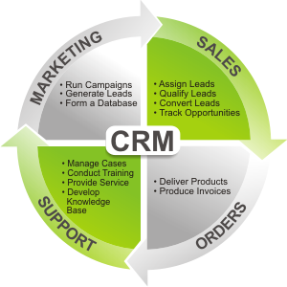
CRM Strategies

Slide 13
Customer Retention Marketing Techniques
Customization: Changing the product (not just the marketing message) according to user preferences
Customer co-production: Allows the customer to interactively create the product
Customer service tools include:
  Frequently asked questions
  Real-time customer service chat systems
  Automated response systems

Slide 14
Benefits of using CRM
Centralized customer interaction
Improved customer support and satisfaction
High rate of customer retention
Increase revenue and referrals from existing customers
Improve your products/services
Measure and optimize your performance
Boost new business

Slide 15
Enterprise Information Management
Enterprise information management (EIM) is a set of business processes, disciplines and practices used to manage the information created from an organization's data.
EIM initiatives seek to build efficient and agile data management operations with capabilities for information creation, capture, distribution and consumption.
The goal is to provide and preserve information as a business asset that remains secure, easily accessible, meaningful, accurate and timely.

Slide 16
Enterprise IT Management
EITM is a strategy conceived and developed by Computer Associates International which details how organizations can transform the management of IT in order to maximize business value.
Strategy for increasing the business relevance of the IT function, EITM considers the need for IT organizations to start operating as a service-based business.
Ensuring investments are prioritized according to business strategy and that operational efficiencies can be more quickly realized and costs reduced when IT processes are integrated and automated.
Notes:
CA Inc: Computer Associates International

Slide 17
Role of IT in Enterprise Management
Enterprise IT Management was developed in response to a growing need by IT organizations to gain more value from investments made in IT capabilities, infrastructure and resources.
EITM proposes a set of capabilities that enable IT to better govern, manage and secure the IT services delivered to the business.
IT/IS as asset, “strategic weapon”, “nervous system” (strategic level) Vs tool, commodity (operational level)
Notes:
Management of information technology (IT) and information systems (IS, systems) is similar to “Management Information Systems” (MIS) which Utilizing IT/IS and information these support to solve business problems and support organizational performance.

Slide 18
Enterprise Information Systems
Enterprise information system (EIS) is a system that serves an entire enterprise or at least two functional departments in:
  Business intelligence (BI)
  Enterprise resource planning (ERP)
  Knowledge management (KM)
  Partner relationship management (PLM)
  Business process management (BPM)
  Customer relationship management (CRM)

Slide 19
Role of IS in Enterprise Management
Help to unify the firm’s structure and organization: One organization
Management: Firm wide knowledge-based management processes
Technology: Unified platform
Business: More efficient operations & customer-driven business processes
Supporting the major business functions: sales and marketing, manufacturing and production, finance and accounting, and human resources

Slide 20
Role of IS and IT in Enterprise Management
Reduce Costs/ Improve Productivity
Improve Customer Satisfaction/ Loyalty
Create Competitive Advantage
Generate growth
Streamline Supply Chain
Global Expansion

Slide 21
What do Enterprise Engineers do?
Identify and Integrate best and most successful ways to change an enterprise

Slide 22
What do Enterprise Engineers do?
Two aspects
  Understand new mechanisms
    New ways of organizing work
    New Corporate Architectures must be understood
  Understand methods that can change an enterprise

Slide 23

Two questions Enterprise Engineers always ask
What should the enterprise be?
How do we get there from here?

Slide 24
Enterprise Engineering
Enterprise Engineering is integrated set of disciplines for building or changing an enterprise, its processes, and systems.
It integrates the most powerful change methods and makes them succeed.
The goal is a human-technological partnership of maximum efficiency in which learning takes place at every level.

Slide 25
Goal of the Enterprise Engineer
Identify and integrate the most valuable and successful ways to change an enterprise, and to take them into a professional discipline with a teachable methodology and measures of effectiveness.

Slide 26
Need for Enterprise Integration
Integration of markets
Integration between several development and manufacturing sites
Integration between suppliers and manufacturers
Integration of design and manufacturing
Integration of multi-vendor hardware and software components

Slide 27
Basic principles for integration
Provide the vision, right information, resources, and responsibility
Empowered people
A comprehensive and effective communication networks
Democratization and dissemination of information
Freely shared information

Slide 28
Two major issues of Enterprise Integration
How to motivate employee
How to provide employee with the right information to do their jobs

Slide 29
Types of Integration
Loose Integration versus Full Integration
Horizontal Integration versus Vertical Integration
Intra-Enterprise Integration versus Inter-enterprise Integration
System Integration, Application Integration, and Business Integration

Slide 30
Loose Integration versus Full Integration
Loose Integration - If two systems can merely exchange information with one another with no guarantee that they will interpret this information the same way
Full integration - Two systems are fully integrated if and only if
  the specificities of any one of these systems are only known to the system itself and not by the other one,
  the two systems both contribute to a common task, and
  the two systems share the same definition of each concept they exchange

Slide 31
Horizontal Integration versus Vertical Integration
Horizontal Integration - concerning physical and logical integration of business processes from product demand to product shipment, regardless of the organizational boundaries.
Concerning the technological flow
Vertical Integration - concerns integration between the various management levels of the enterprise, i.e. decision-making integration, where a management level defines the set of constraints for its lower management levels, which in turn send feedback information to their upper management level, and so on.
Concerning the decision flow

Slide 32
Intra-Enterprise Integration versus Inter-Enterprise Integration
Intra-Enterprise Integration - the integration of the business processes internal to a given enterprise. (Full integration)
Inter-Enterprise Integration - the integration of business processes of a given enterprise with business processes of other enterprises, or even sharing some parts of business processes by different cooperative enterprises. (Loose integration)

Slide 33
System Integration, Application Integration, and Business Integration
Physical System Integration - concerning System communication
Application Integration - concerning Interoperability of applications
Business integration - concerning Business process coordination

Slide 34
Alignment Process
Developing a common understanding among the key stakeholders of the purpose and goals of the project and the means and methods of accomplishing those goals is called the Alignment Process.
It is important to accomplish this alignment during the initiation phase.
Project managers usually conduct a start-up meeting that is sometimes called a kickoff meeting.

Slide 35
Alignment Process (Continued)
The agenda and duration of the start-up meeting depends on the complexity level of the project.
Projects with a limited scope and short duration may engage in a session start-up meeting over lunch.
A medium-complexity project will require more-hour meeting while a high-complexity project cannot achieve alignment in a single meeting. Alignment can require several days of activities.

Slide 36
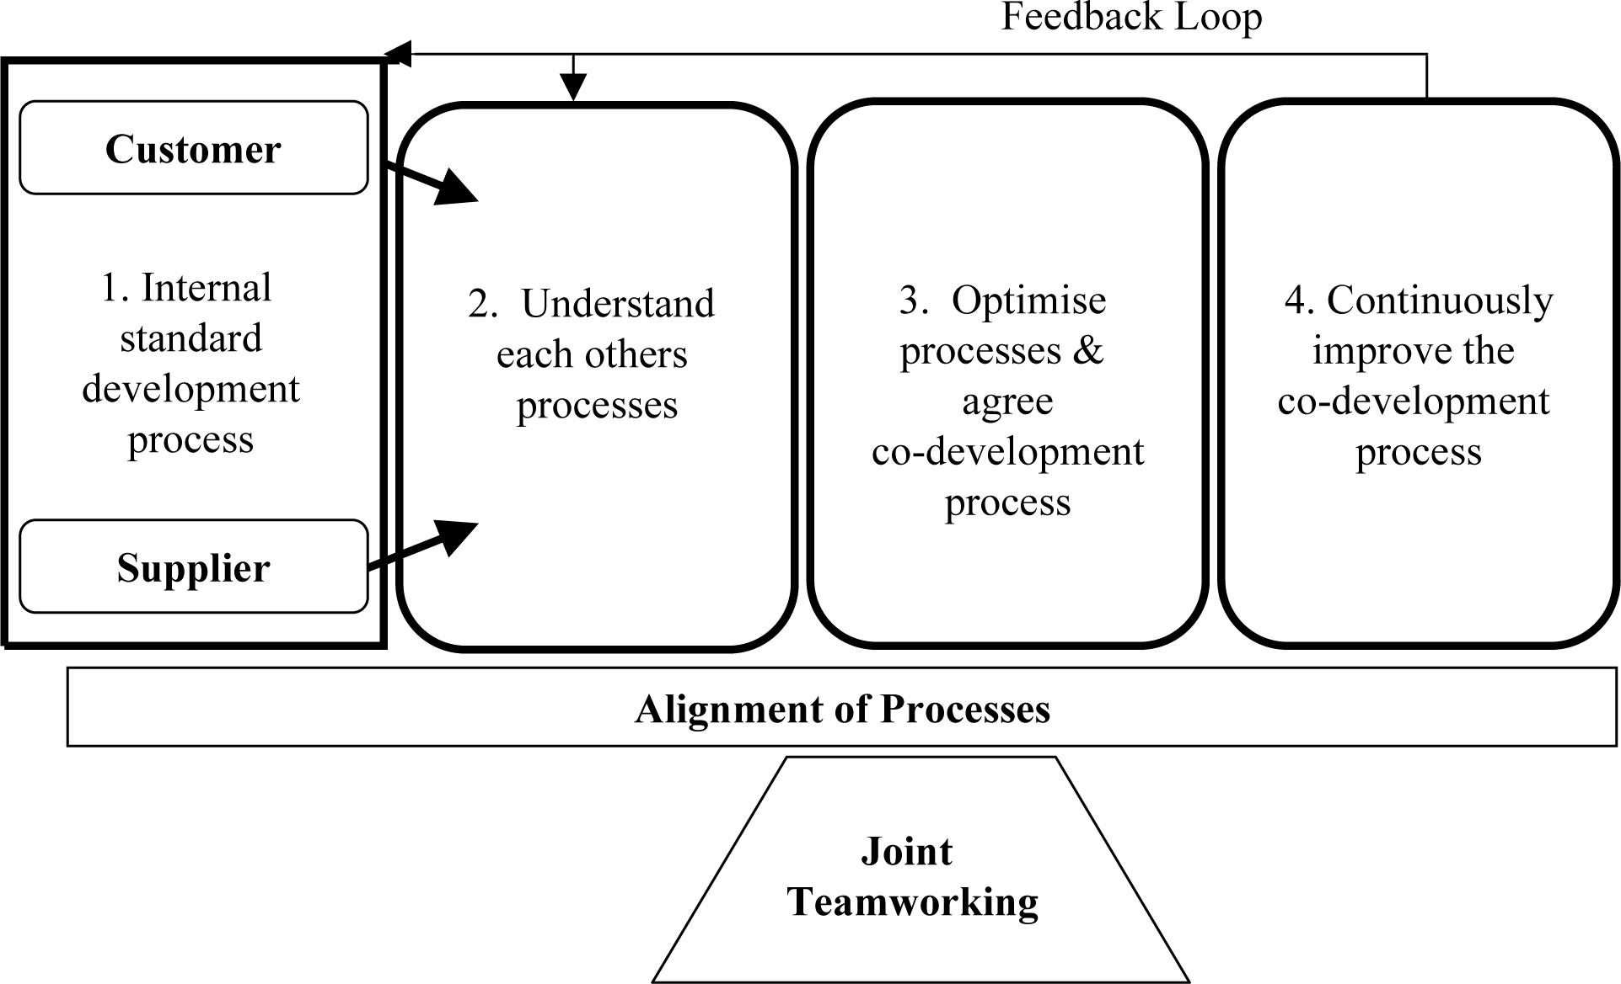
Alignment Process

Slide 37
Objective of Alignment Process
The purpose of the alignment process is to develop a common understanding of the purpose, agree on the means and methods, and establish trust.
The components of the alignment process are discussions of the purpose, goals, participant roles, methods of tracking progress and costs, methods of managing change, and building trust.
The effects of a lack of trust are delays caused by fact checking or missing information that was not shared because the person’s discretion was not trusted to handle sensitive information.

Slide 38
Final Words
“Doing your best is not enough.”
W. Edwards Deming
You must know what to do, how to do it and be willing to pay the price to do it.

